Slide 1
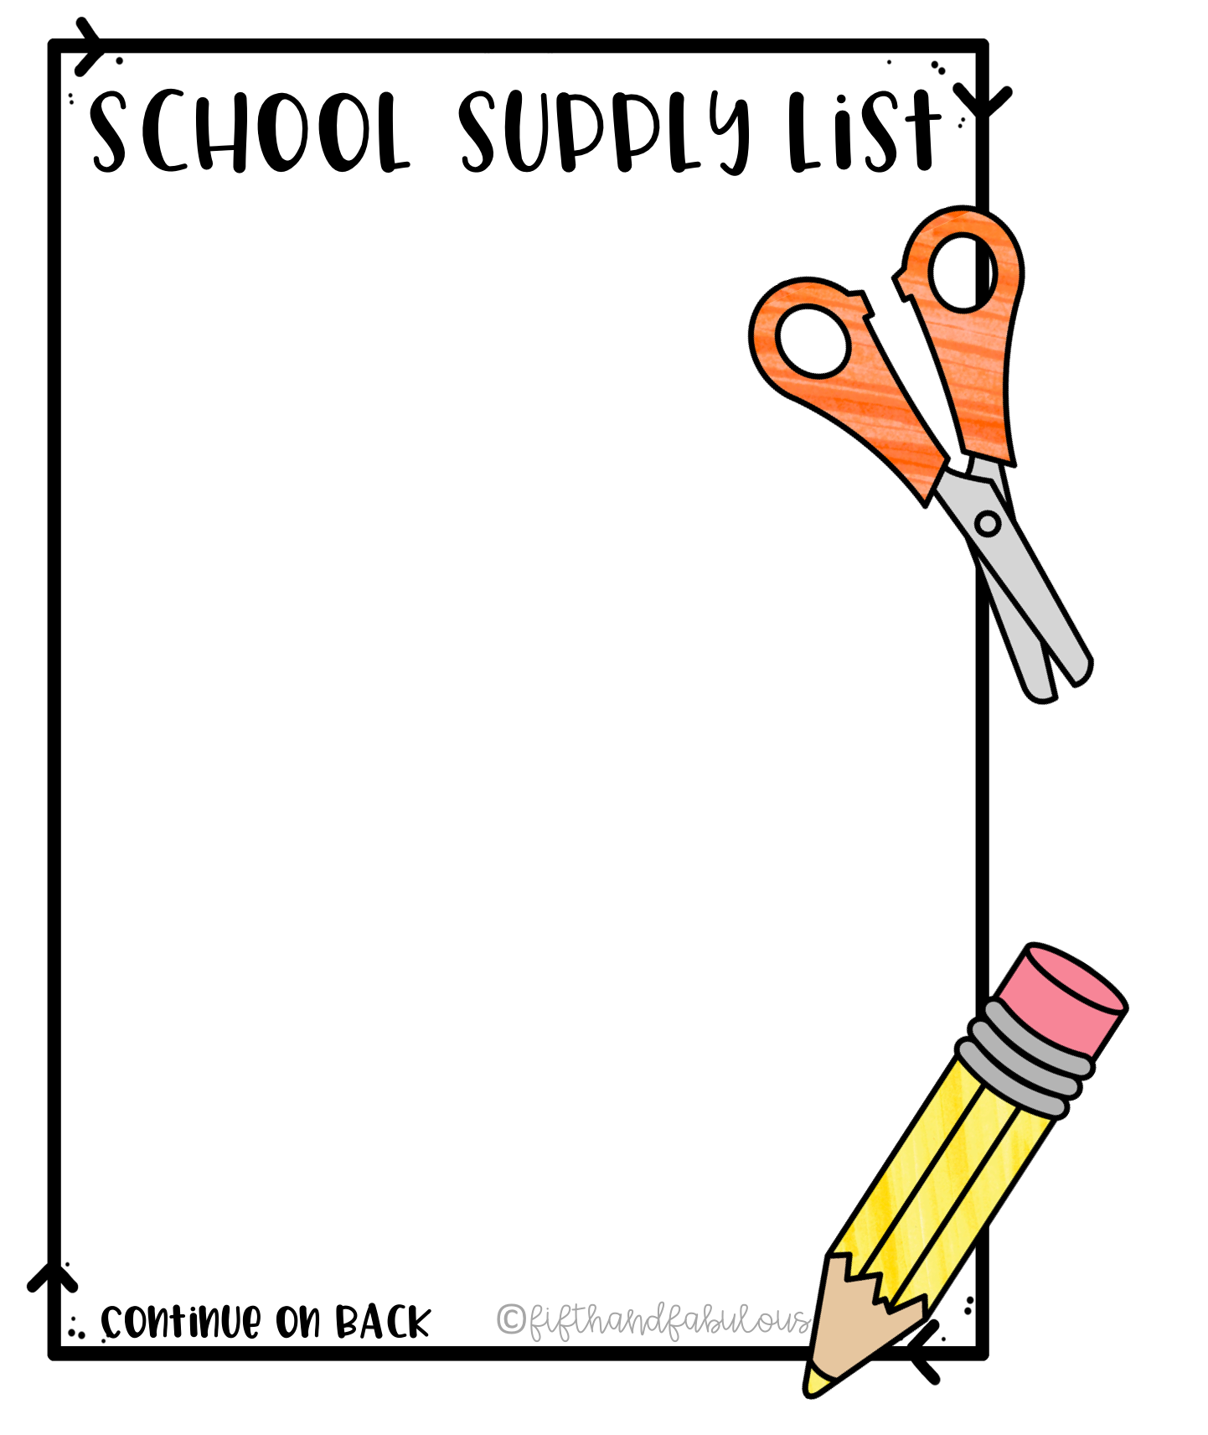
Gifted Learning Center
MUST HAVE:
Refillable Water Bottle
Backpack
Personal Headphones
Wired mouse (recommended)
Shared Supplies
Colored Pencils
Markers (Crayola or Mr. Sketch)
Ziploc Bags (variety of sizes)
Dry Erase Markers
Glue sticks and hot glue sticks
Disinfecting Wipes
small white board erasers
White Cardstock
Bandaids (dots & small sizes)
If your child wants their own to keep in their cubby you may consider the following supplies.
Crayons
Colored pencils
Child’s favorite snack
Scissors
Pencils
Glue sticks

