Slide 1
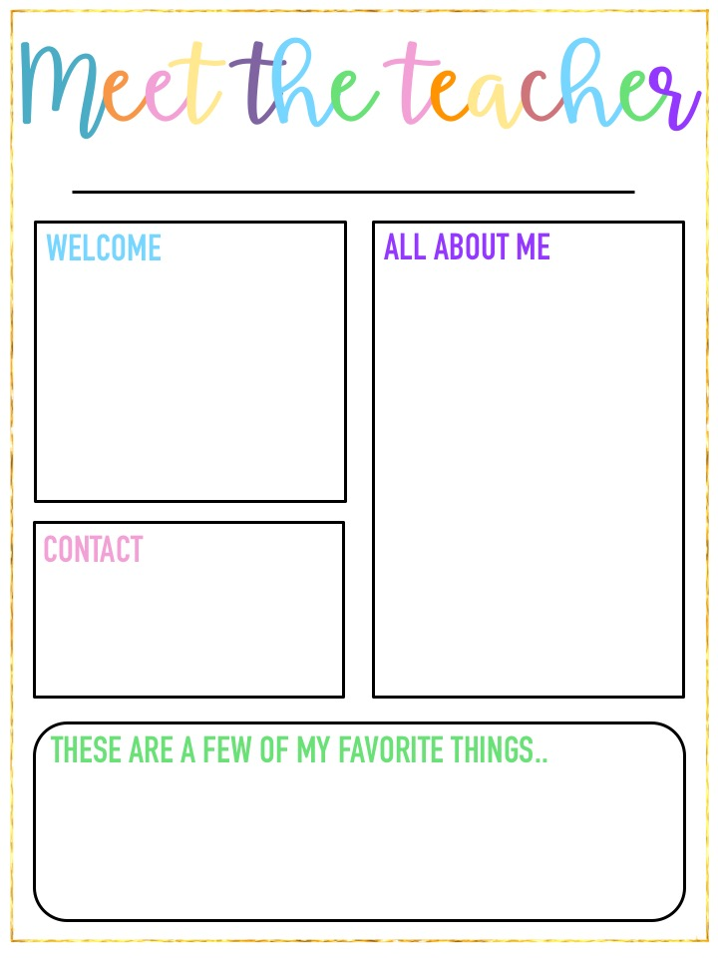
Ms. Harding
Welcome to second grade! This year will be filled with many learning opportunities, new experiences and fun adventures. I can’t wait to meet you!
I am Ms. Harding. This is my sixth year teaching second grade at Sahuaro. I received my Bachelors Degree in Early Childhood and Special Education at ASU. I am passionate about teaching and the importance of education in every child’s life.
Classroom: 602-896-6246
Email: katherine.harding@wesdschools.org
Color: Yellow School Subject: Social Studies
Season: Winter Fruit: Strawberries
Drink: Cherry Vanilla Coke Store: Target
Looking to make a donation? Our class can always use tissues, hand sanitizer and cleaning wipes! Thank you!

